Slide 1
NYPD Shooting Incident Data Report
By: Dhanushga Lionel

Slide 2
Steps
Download the dataset from https://data.cityofnewyork.us/api/views/833y-fsy8/rows.csv?accessType=DOWNLOAD
Looked at the summary of the data to see what I needed
Cleaned up missing data/empty data cells by putting NA using the na_if function
Mutated the data from a character column to date column to make my analysis
Removed columns that I didn’t need (Latitude, Longitude, X_COORD_CD, Y_COORD_CD, Lon_Lat)

Slide 3
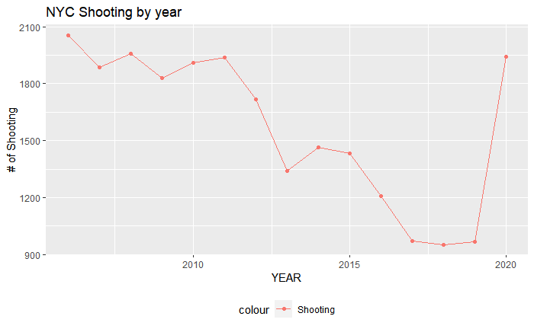
Visualize Shooting by year

Slide 4
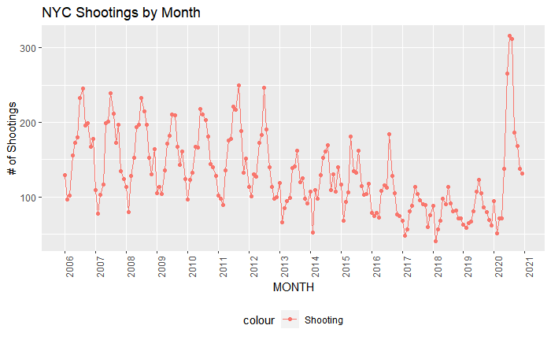
Visualize Shooting by month

Slide 5
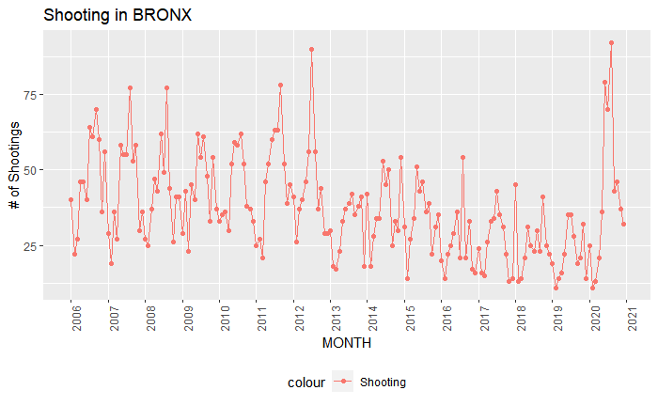
Visualize Shooting in the Bronx by Month

